Slide 1
ISO 15926-4 RDL questions

Slide 2
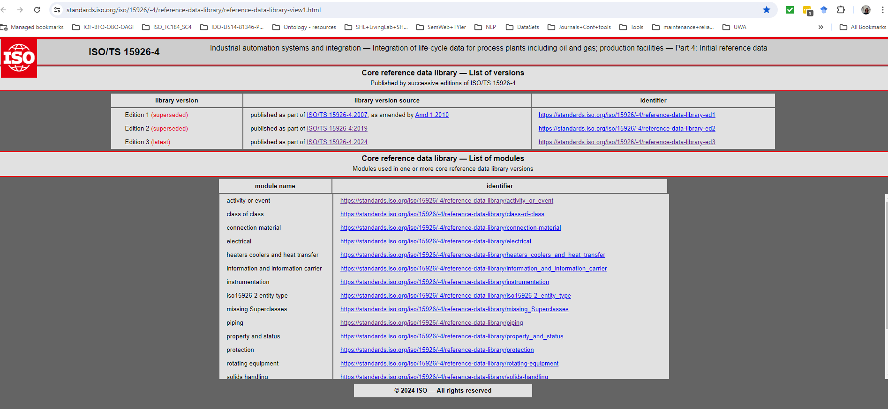
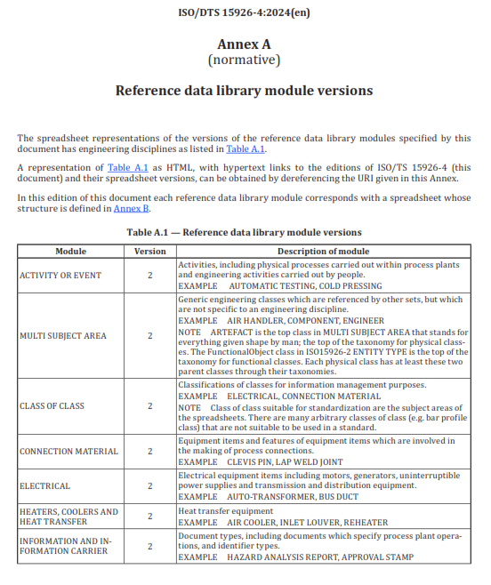
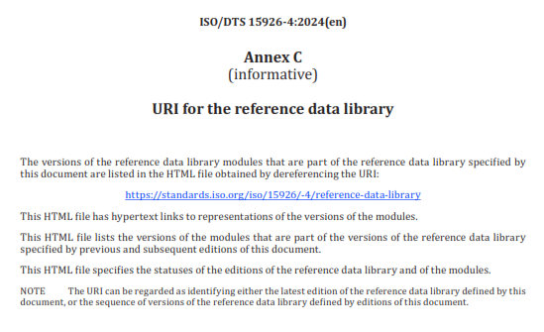
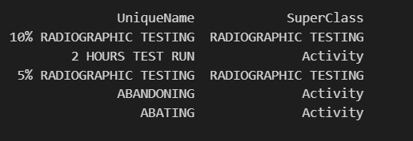
Data processing
Data Processing
Exported the above files.
Extracted UniqueName, SuperClass1, SuperClass2, SuperClass3 and SuperClass4 columns
Appended files to form one two column file appended_files_clean.csv
20,881 rows
File header …..
2

Slide 3
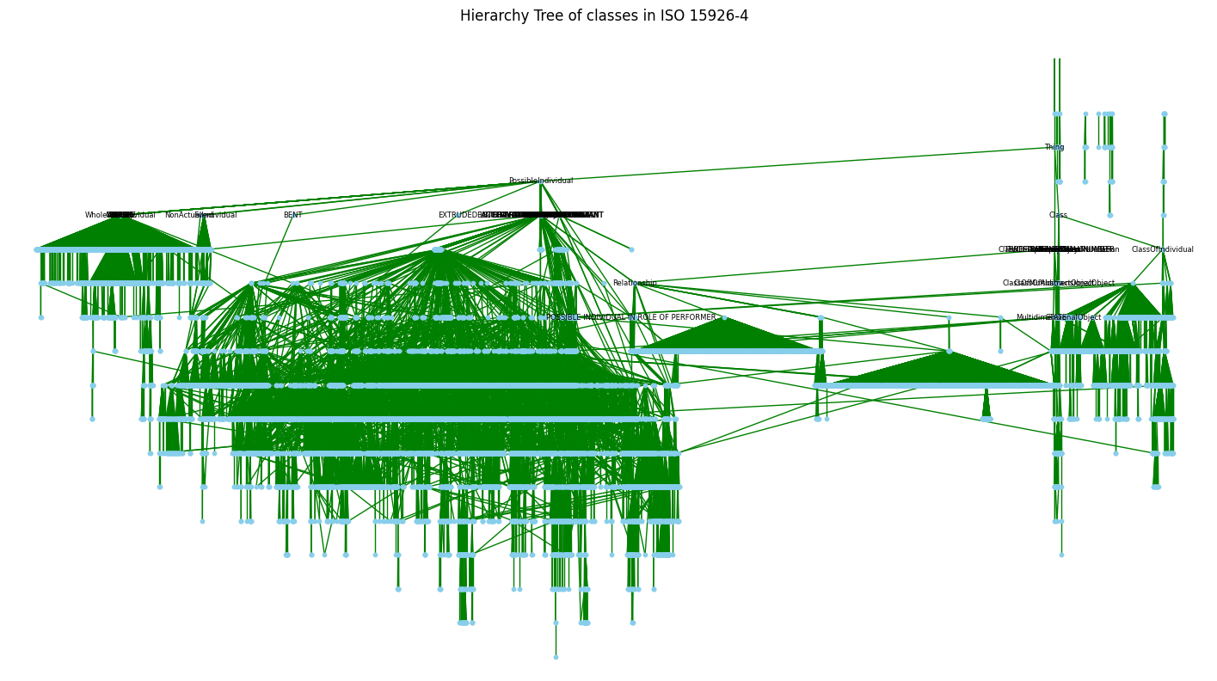
What does the whole 15926-4 hierarchy look like?
3

Slide 4
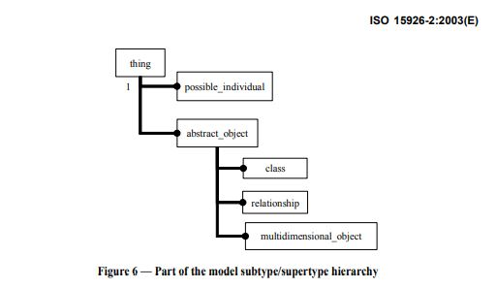
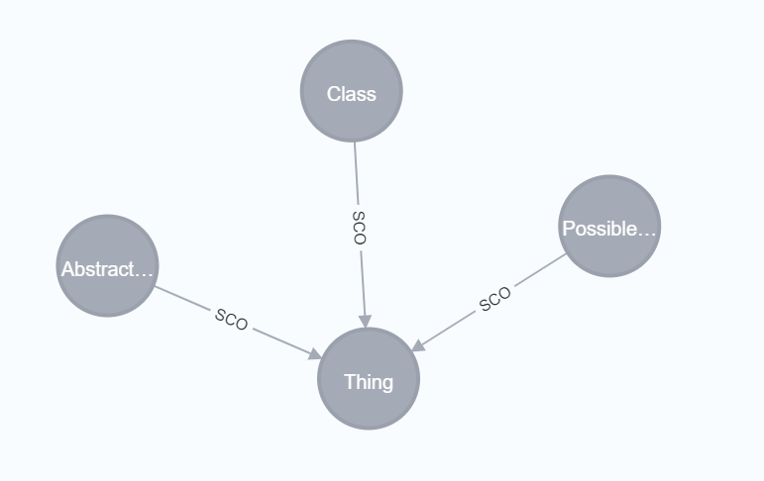
Explore ‘Thing’ relationships
MATCH (n {UniqueName: "Thing"})-[r](connectedNodes) RETURN n,r,connectedNodes
In the appended_files_clean.csv, Class is a subclass of Thing but this does not match with Fig 6 in ISO 15926-2.
4

Slide 5
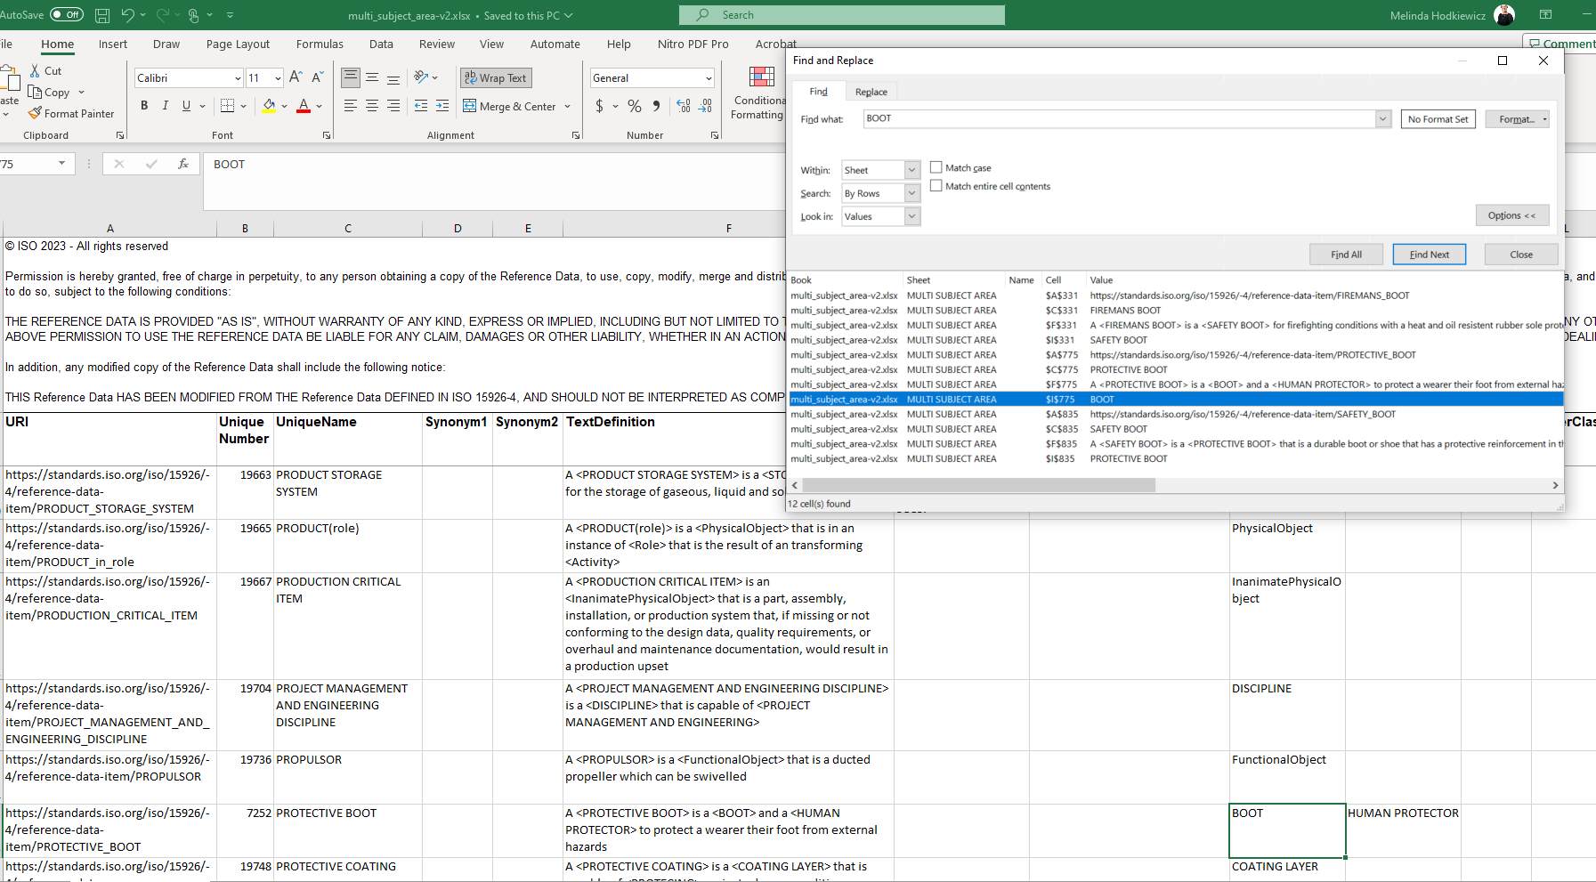
Why are there more top-level classes than just ‘Thing’?
Top-level nodes:
BAR PROFILE
BARREL EMPTYING PUMP
BOOT
BUSHING
CABLE FASTENER
CERTIFICATE ISSUER NAME
CLIP
CLUTCH
CONNECTOR
CREATION EVENT
CUTTING TOOL
DELIVERY EVENT
DISTANCE
DISTILLER
DOWNHOLE SAFETY RELIEF VALVE
DRILLING MACHINE
ENCODED DATA
FLUID TRANSPORTER
FOAM
GAS SYSTEM
HEAT DETECTOR
IDENTIFYING STRING
INDEX NUMBER
PATH
PIPING SPECIFICATION
POLYMER
PROCESS SIMULATION ALGORITHM
PRODUCT SCREEN
REAMER
SMOKE DETECTOR
SOLID COMPOUND
TANK COMPONENT
THERMOPLASTIC
Thing
VECTOR
VOLCANIC ROCK
WATER SYSTEM
instrument process connection
MATCH (n1)
WHERE NOT (n1)-[:SCO]->()
RETURN n1
ORDER BY n1.UniqueName ASC
5

Slide 6
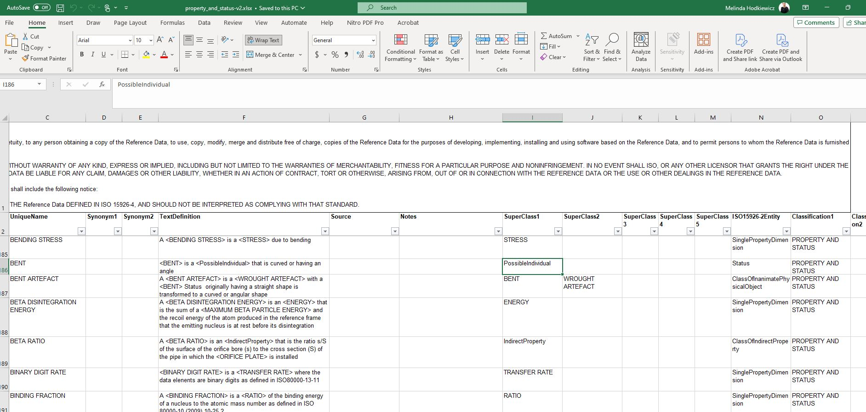
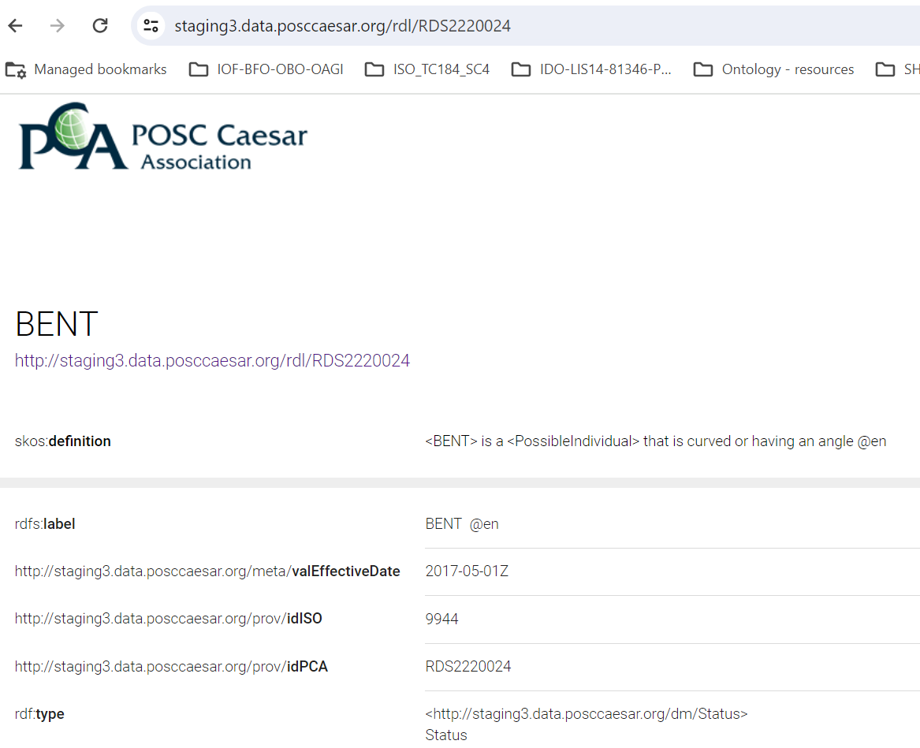
Examine ‘bent’ as ‘PossibleIndividual’
Also checked PCA RDL p3 https://staging3.data.posccaesar.org/rdl/RDS2220024
6

Slide 7
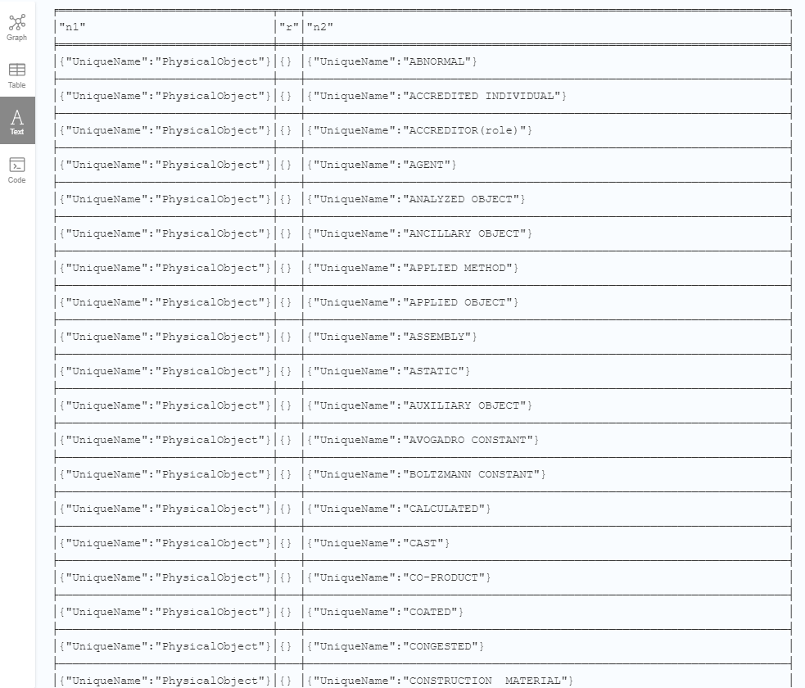
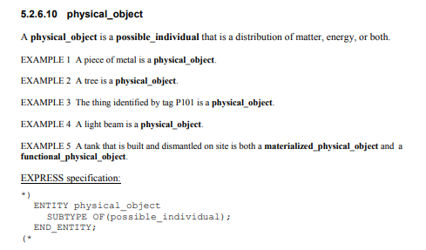
List of nodes connected to Physical Object
MATCH (n {name: ’PhysicalObject'})-[r]-(connectedNodes) RETURN n, r, connectedNodes
Showing 34 of 160 only
7

Slide 8
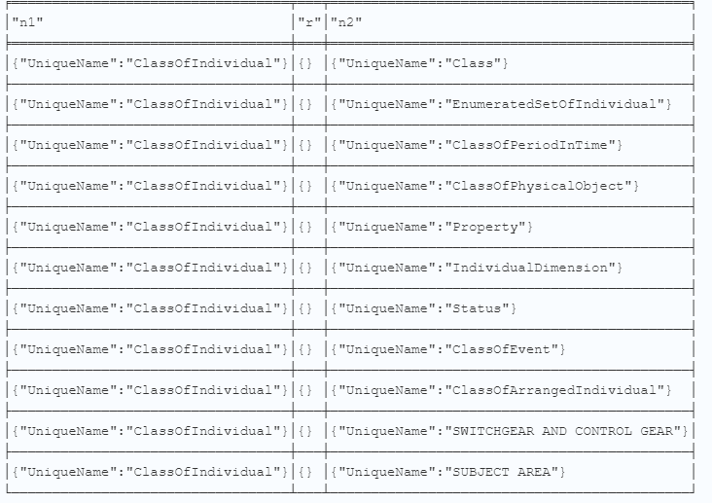
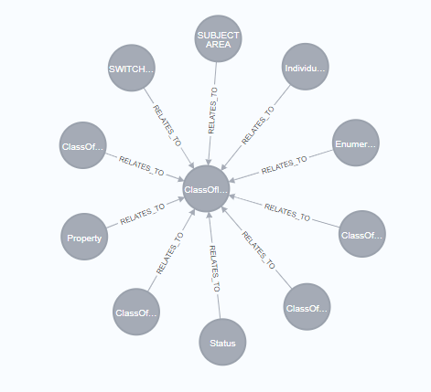
Examine ‘ClassOfIndividual’
Why is <SWITCHGEAR AND CONTROL GEAR> a ClassOfIndividual but no other equipment grouping is a subclass of ClassOfIndividual?
8

Slide 9
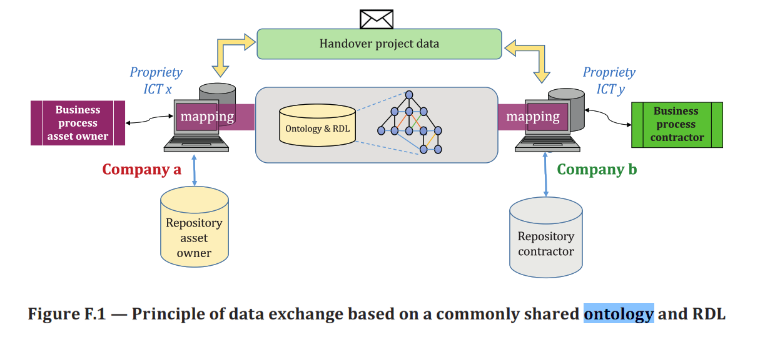
Hypothesis
Is it possible that the main use of ISO 15926-4 by industry is as a dictionary for the RDS value e.g. PUMP http://staging3.data.posccaesar.org/rdl/RDS327239 to allow common IRIs’ to be used?
Is it also possible that users are not using the RDL hierarchy? The fact that these superclass issues have not come to light suggests that the hierarchy is not being used.
Are there examples available of RDL being used in semantic use cases (i.e., to support reasoning) in industry?
9

